Slide 1


BYU Management Society Africa Business Plan Competition 2026
Kachlinks Technologies Aba

Slide 2
Problem or Customer Pain Point
Aba the commercial hub of the eastern Nigeria has a population of approximately 1,230,000.
However, this city is in short of reliable Print Services :
Photo Prints, Enlargement and Framing.
Cut and Print SAV.
Photo book.
Reliable Paper prints
Advance Branding Technology.
Detailed Software Developers
As a result, residents are compelled to patronize companies in Lagos for these services. As a result of this, they incur high travel or waybill costs.

Slide 3
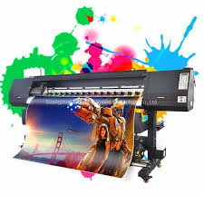
Business Venture, Product, or Service
DIGITAL PRINTING SERVICES
SYNTETHIC PHOTO BOOK .
PRINT AND CUT SAV.
DTG PRINTS.
SYNTETHIC PHOTO ENLARGEMENT AND FRAMING.
BROCHURE PRINTING
OLD PICTURE RESTORING.
SOFTWARE DEVELOPMENT.

Slide 4
Market Size & Growth
Our Target Market are people living in Aba which are approximately 1,230,00.
And The Entire South East and South South parts of Nigeria with a population of over 5 million people.
Our Services targets the adult population starting from Aba the commercial nerve center of South East and South South parts of Nigeria.
We intend to use the best materials for the production of photobooks, brochures and all prints.
Example of this is using synthetic papers, this is because of its durability.
Our fast production (24 hours max) as against the 5 days production timeline giving by most photo book and printing companies.
Our partnership with Kachlinks exprees, Akpoaza rides etc will help us deliver this products when ready to the customers doorsteps within the eastern and south south parts of Nigeria.

Slide 5





Marketing Strategy
SOCIAL MEDIA ADVERTS:
COMMUNITY BASED AWARENESS
BILLBOARDS
POSTERS AND PROMOTIONS
EMAIL ADVERTS

Slide 6
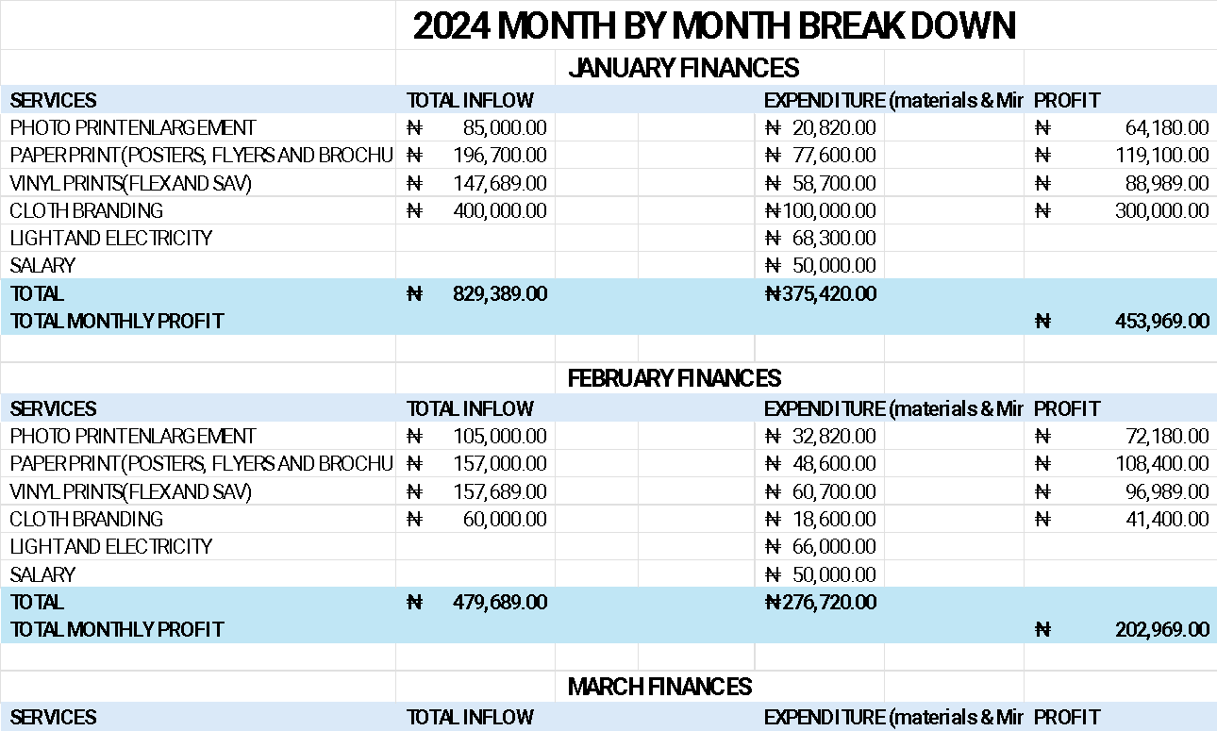
Financials

Slide 7
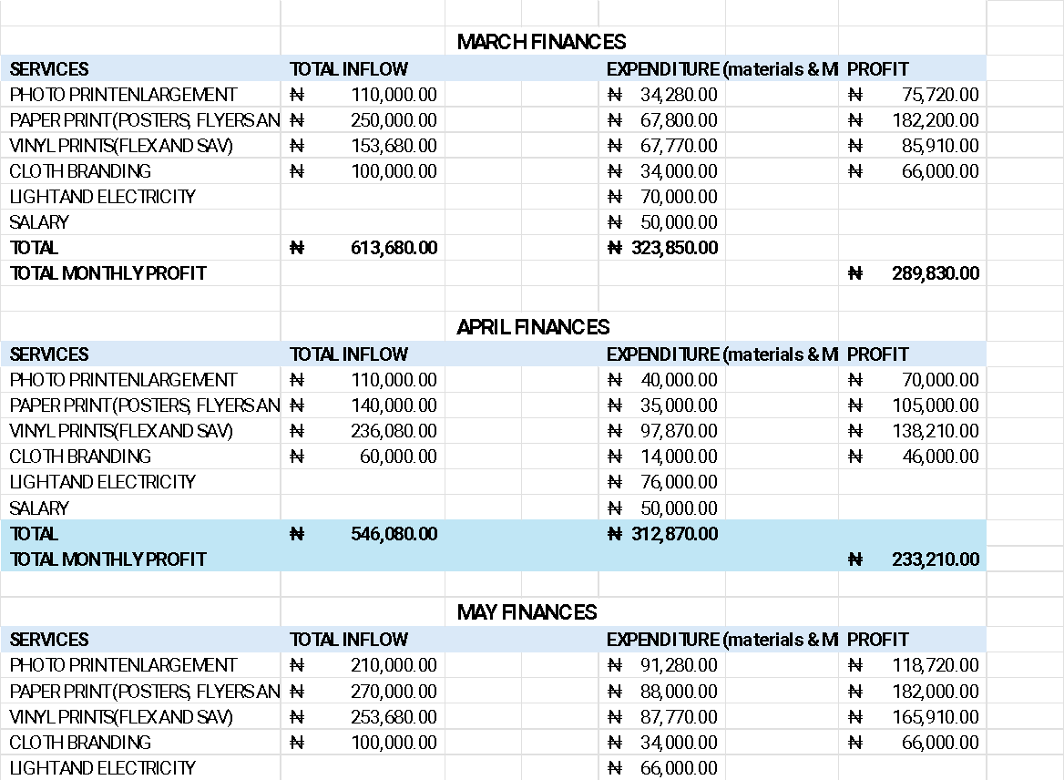


Slide 8
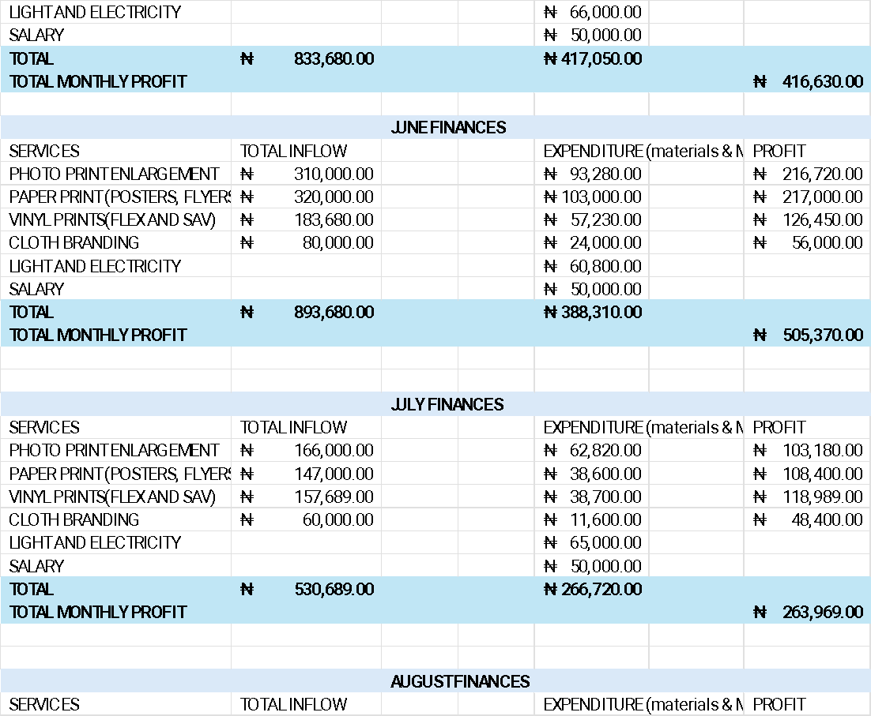

Slide 9
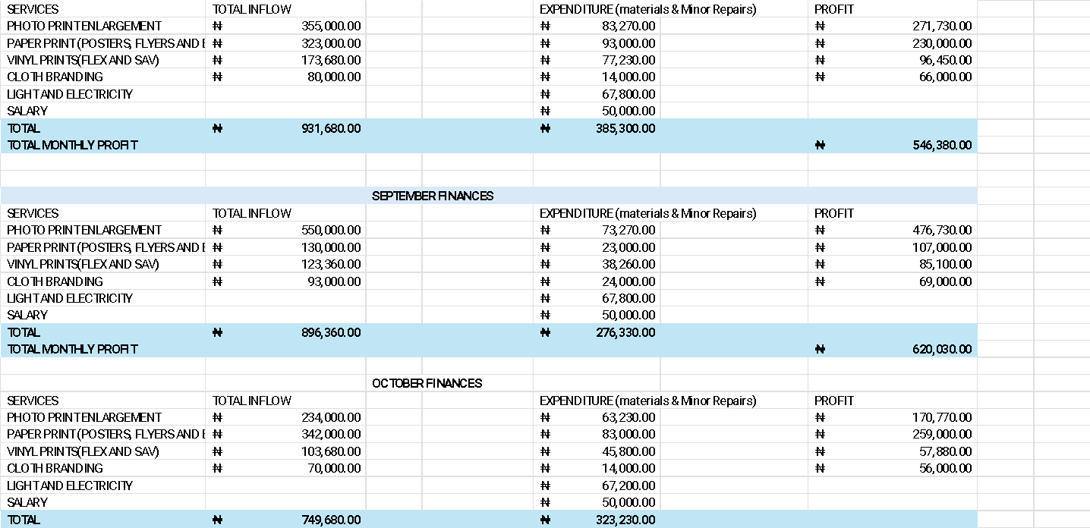

Slide 10
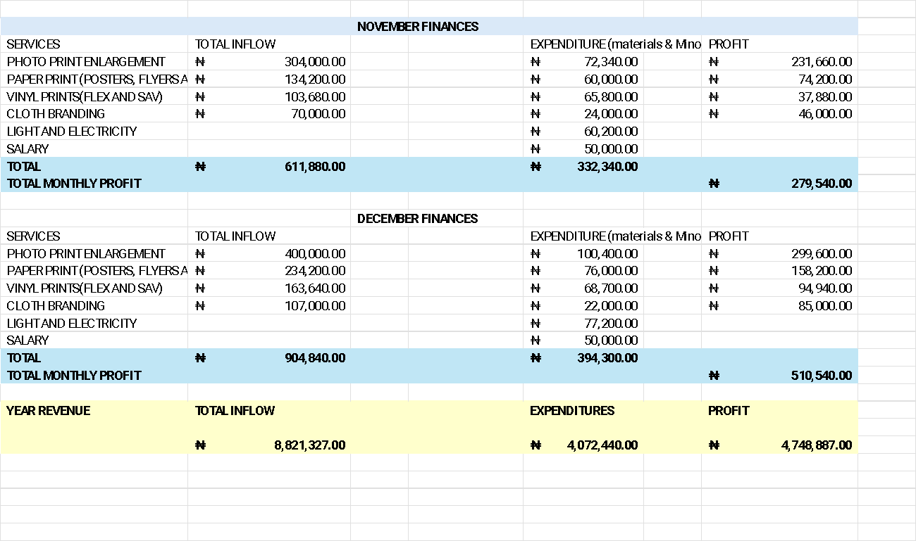

Slide 11
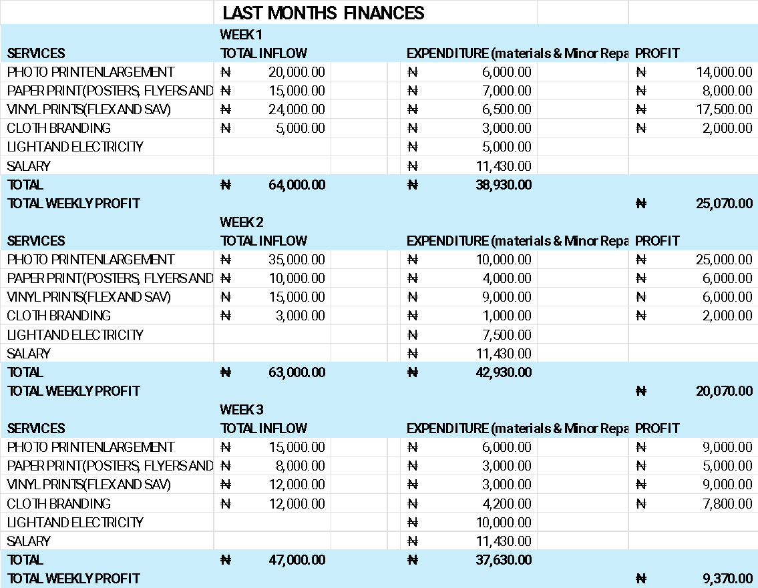

Slide 12
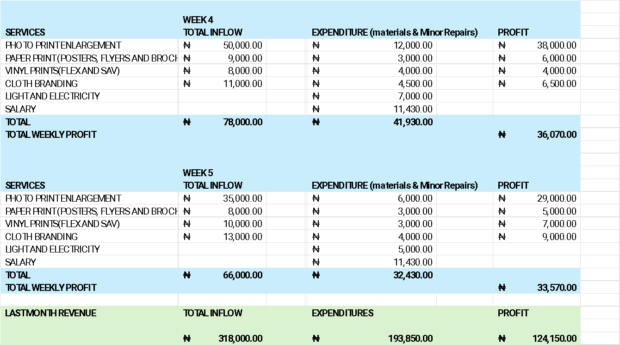

Slide 13
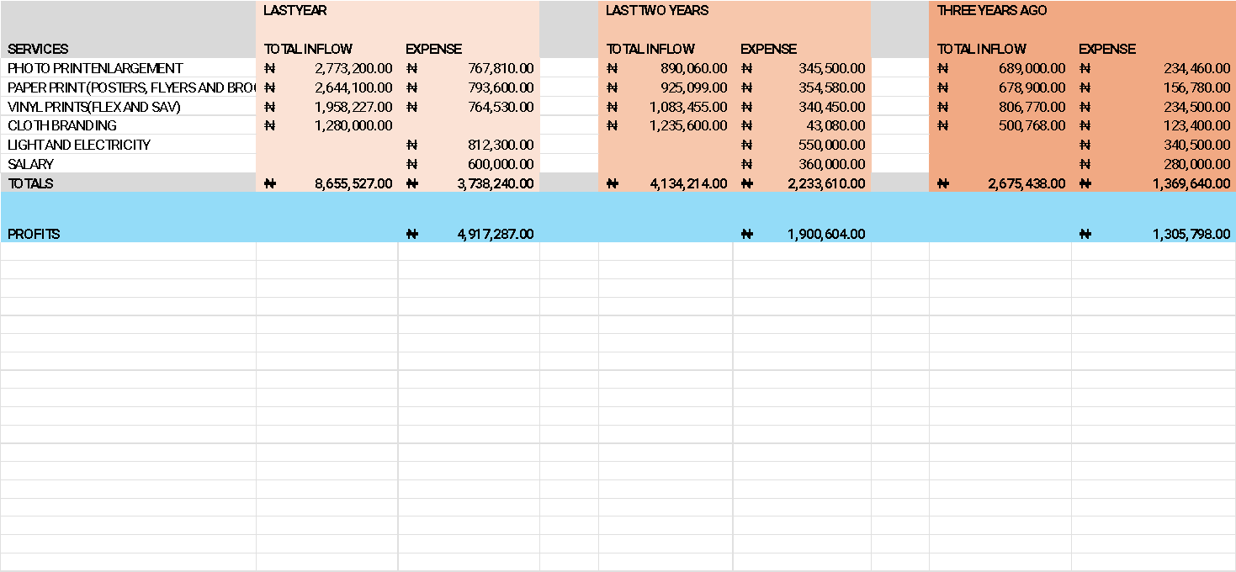
LAST THREE YEARS REVENUE

Slide 14
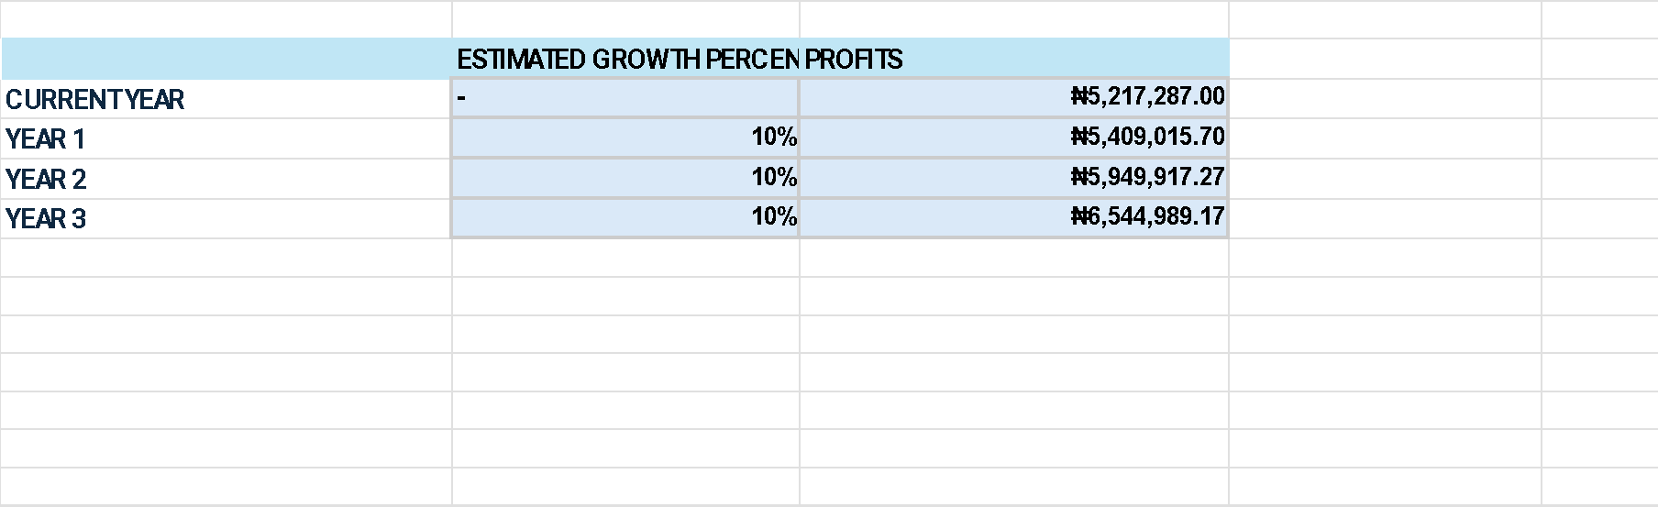
We Estimated a 10% Annual Growth, we are sure that the growth will be greater than the estimate.
This is because the large format image printer, the hot glue machine and the cutter will enable us triple
Production using same energy charges. with this we will not only increase production but minimize expenditure
And maximize profit.

Slide 15
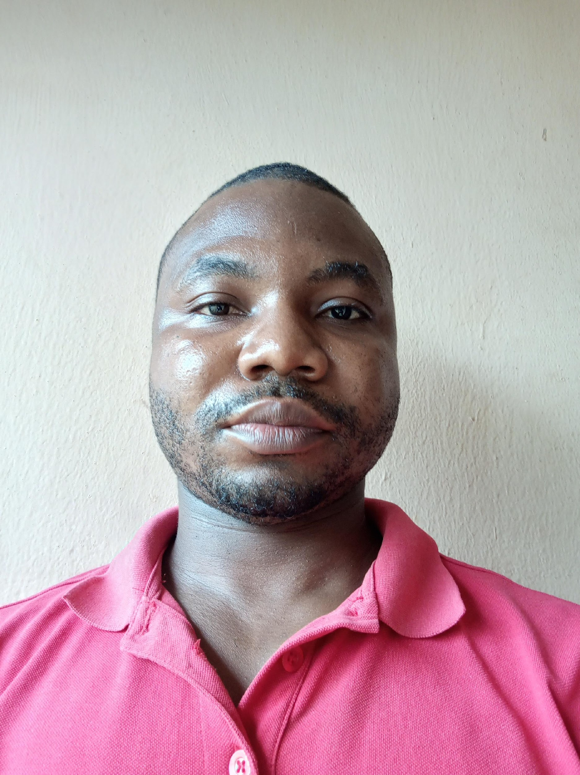
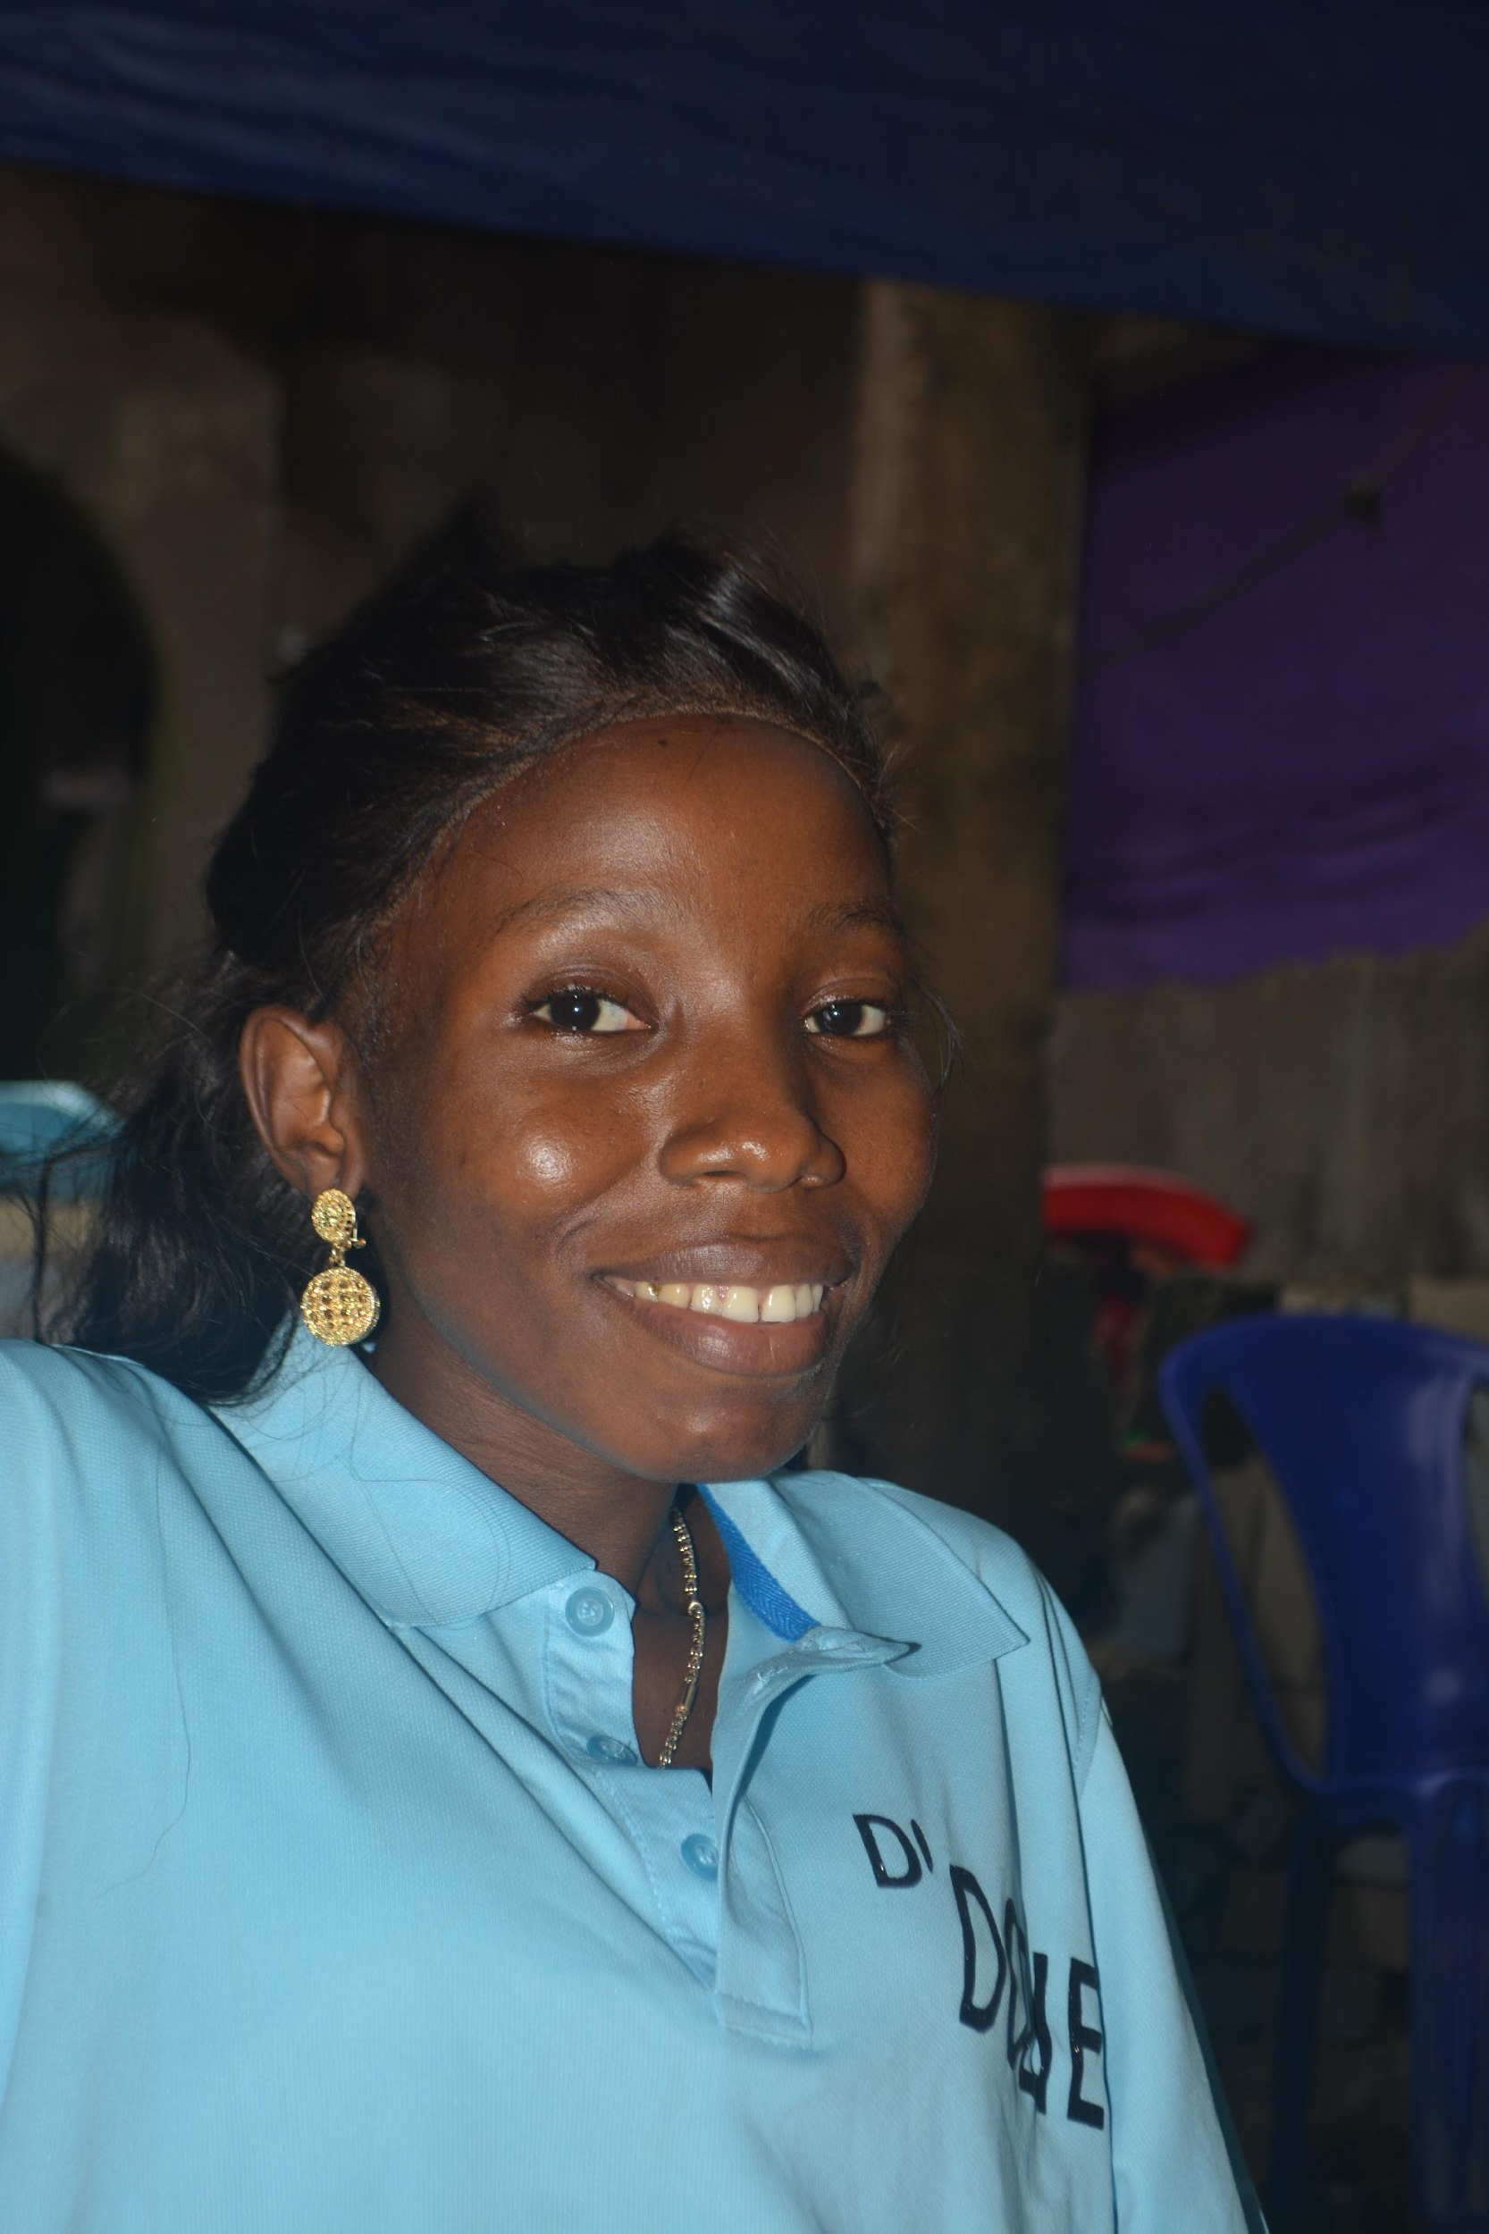
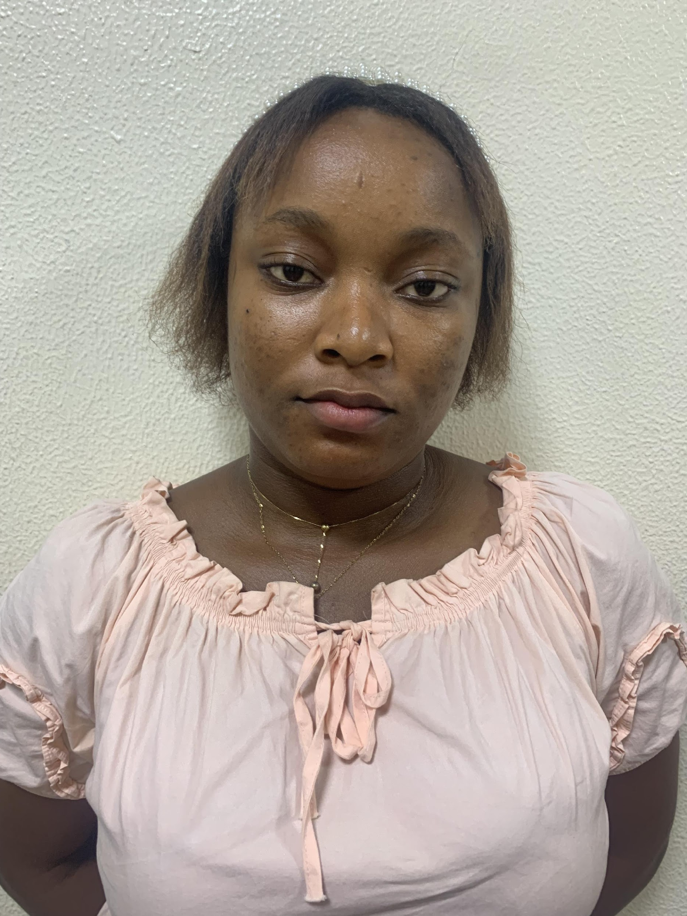
Management Team
Bright Chidozie Onyekachi (CTO)
Mr Onyekachi is a graduate of computer science (HND) Abia State Polytechnic Aba,
And currently enrolled for BsC Software Development in BYU Idaho (online).
Some of his Tech skills includes : web development, mobile app development and graphics design etc.
Esther Ogba Chief Operator
Miss Ogba is a graduate of computer science (HND) Abia State Polytechnic Aba, Some of her skills includes: Graphics Design, Content creation, CTO and Print Machine Operation Etc .
Elizabeth Onyekachi
is the business Manger, she is a manager with many track records in the Design and tech industry.

Slide 16
What will prize money be used for?
Our most sought machines are:
Large format Photo Printer :$1487.05
This will enable us print photos of all sizes, increase production speed and mini cost maximize profit as it’s a fast printer.
Manual Glue Binding Machine : $554
A combination of Large format synthetic photo printer and glue binding machine will not only guarantee neat and fast finishing but will help us produce more than 15 photo books per day, depending on order. It will help use same energy in producing and achieving more products.
Guilotine Paper cutting machine: $134
Having a smaller cutting machine will enable us increase production as we can cut designs and papers at our wish, customize designs in paper prints and save money on paper cutting.
DI Printer (Optional): $334
This will enable us increase production and provide support for the old printer.
Synthetic, Matte Printing and Photo Materials (Optional):
This will help boost production.

Slide 17
Conclusion
Thanks for the opportunity, With your support we believe we will continue to provide solutions to the printing problems in Aba, create more opportunities and change lives.
In God is our Trust.

Slide 18
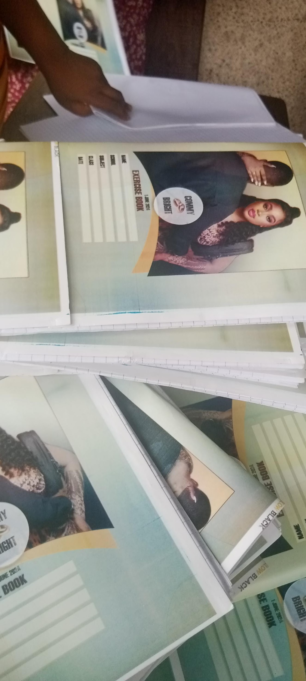
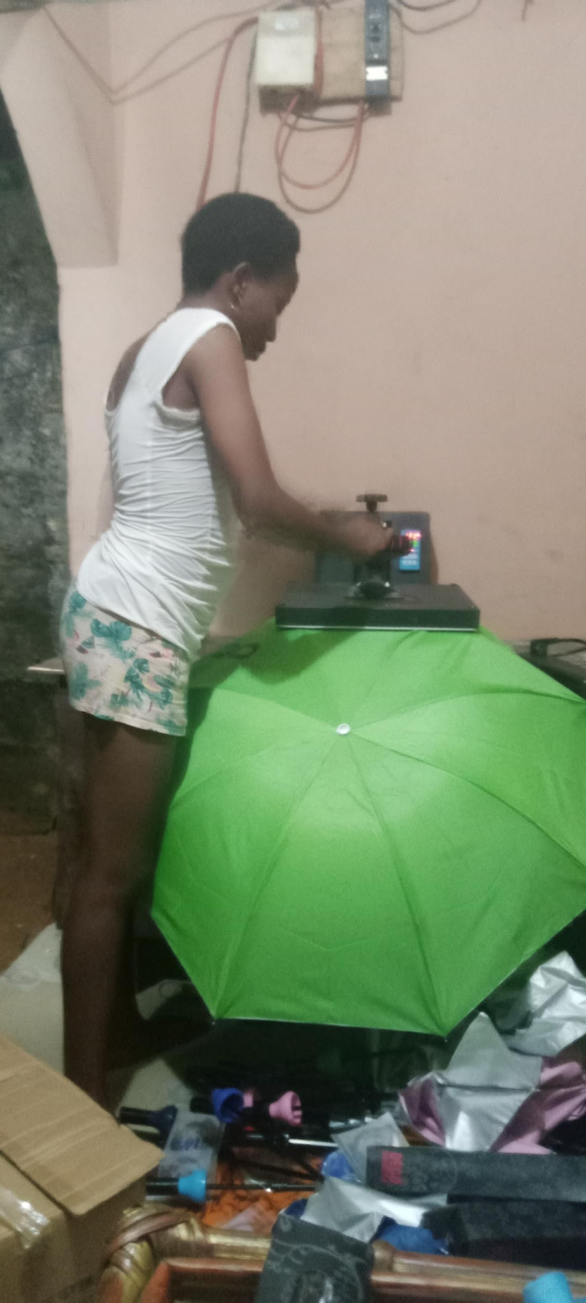
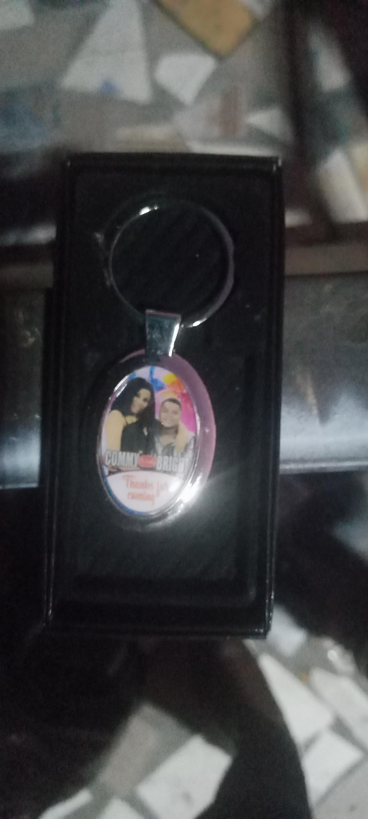
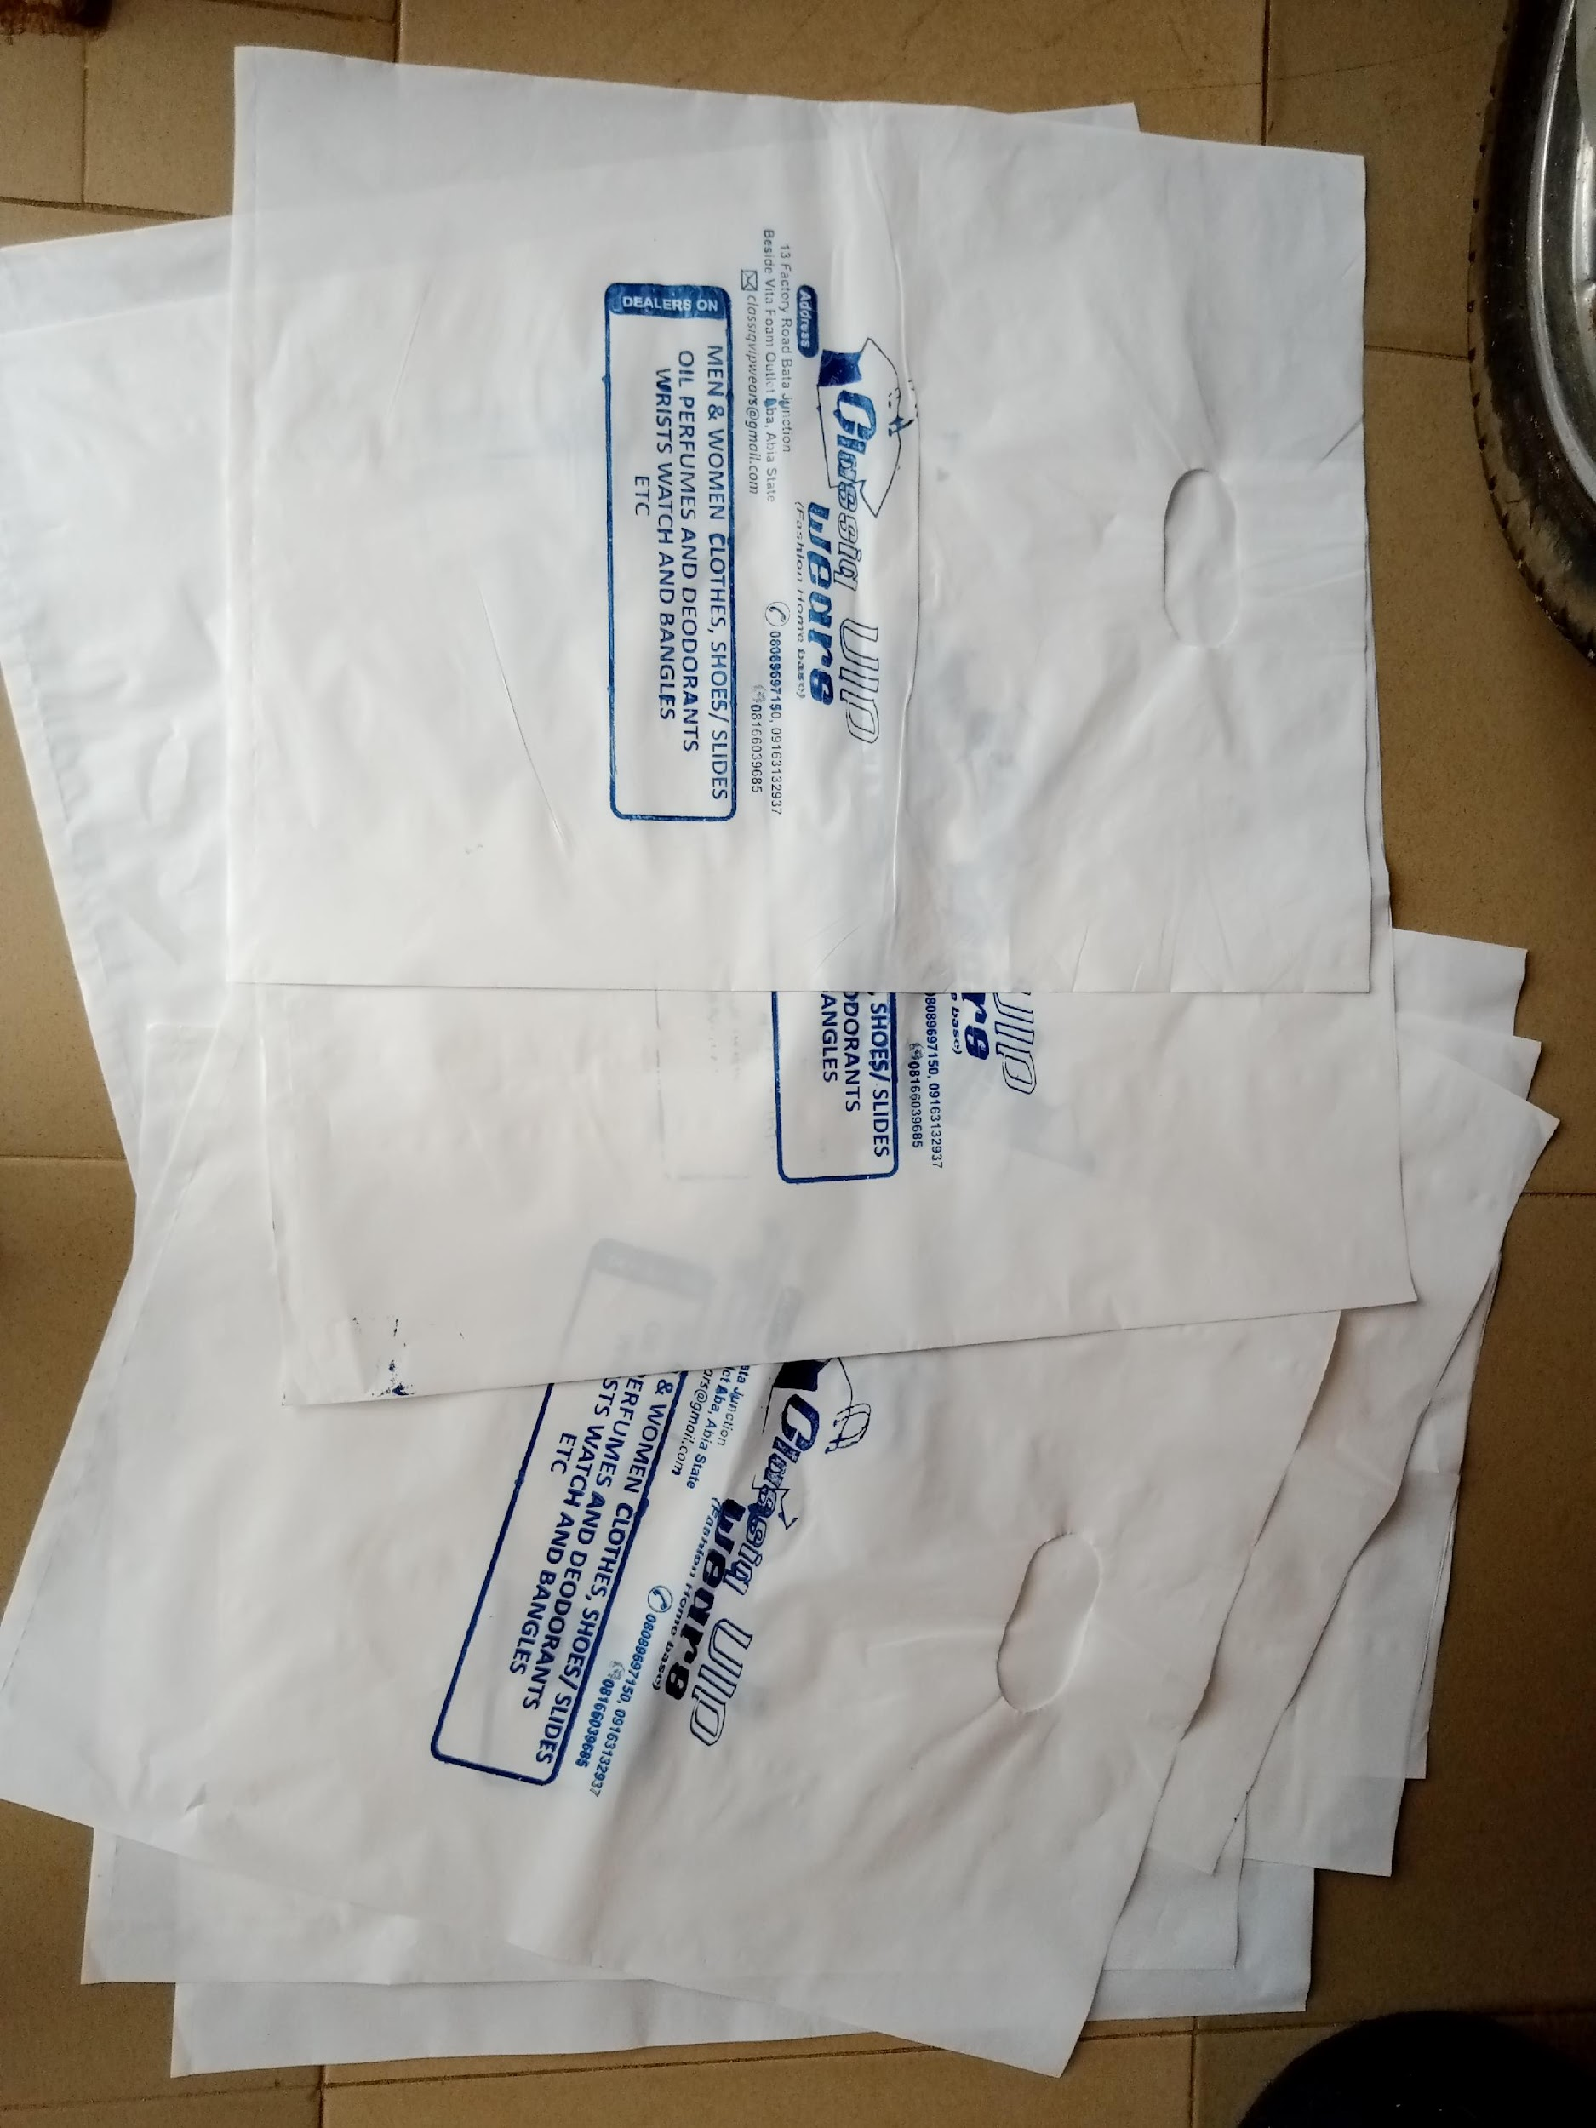
Please add pictures of your business, product, work space, employees, etc. here.

Slide 19
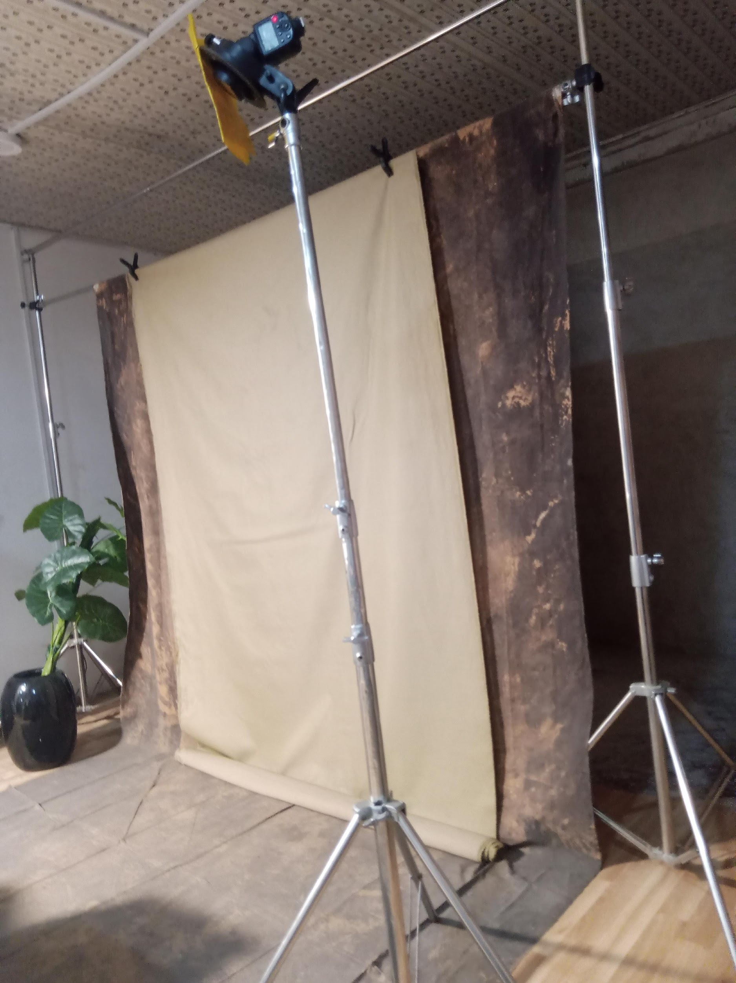
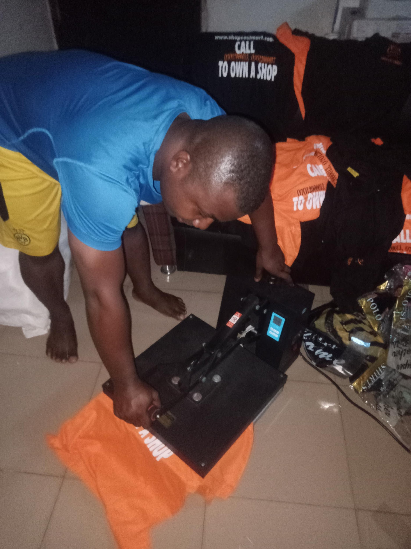
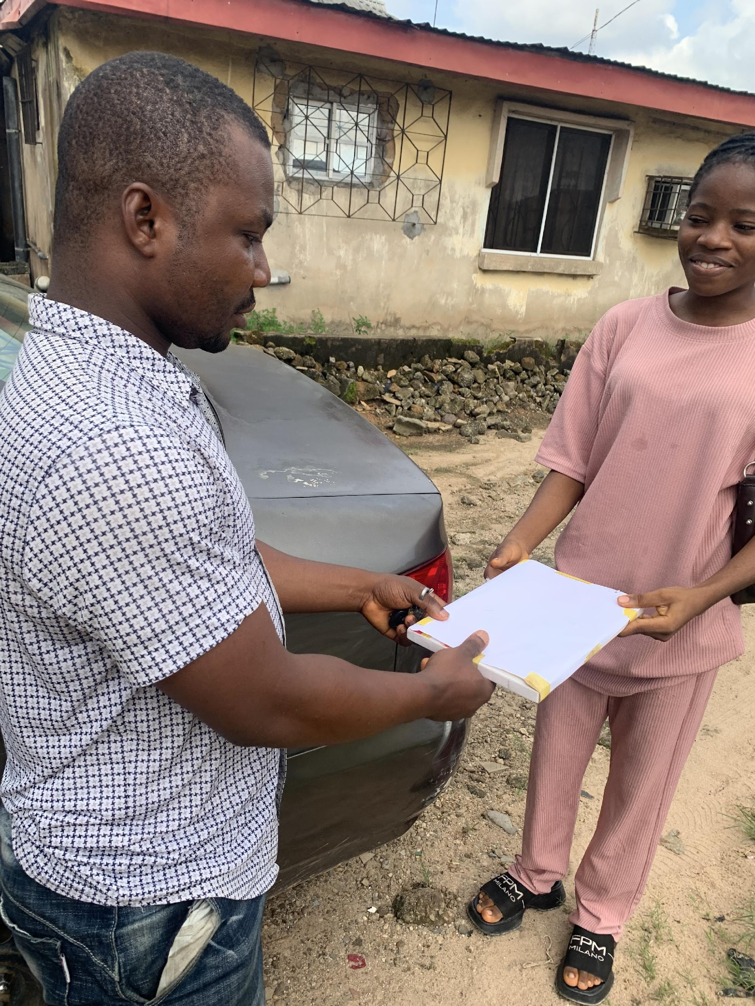
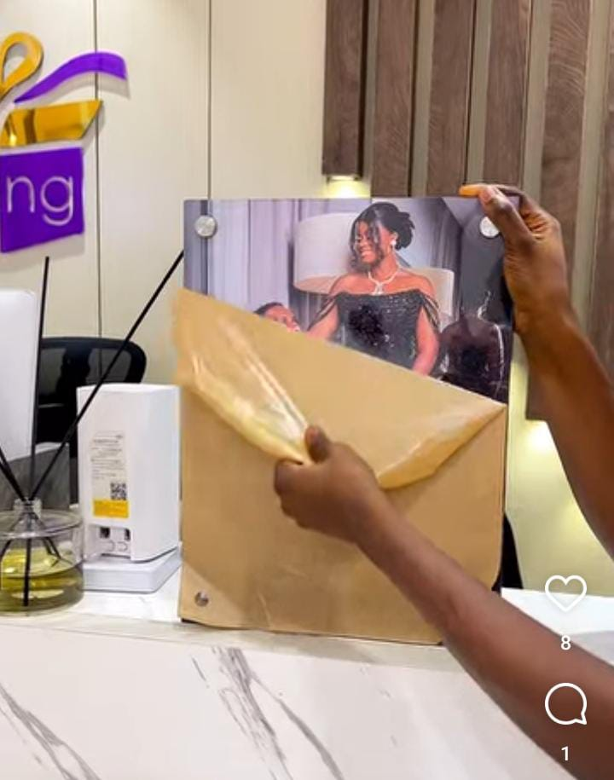

Slide 20
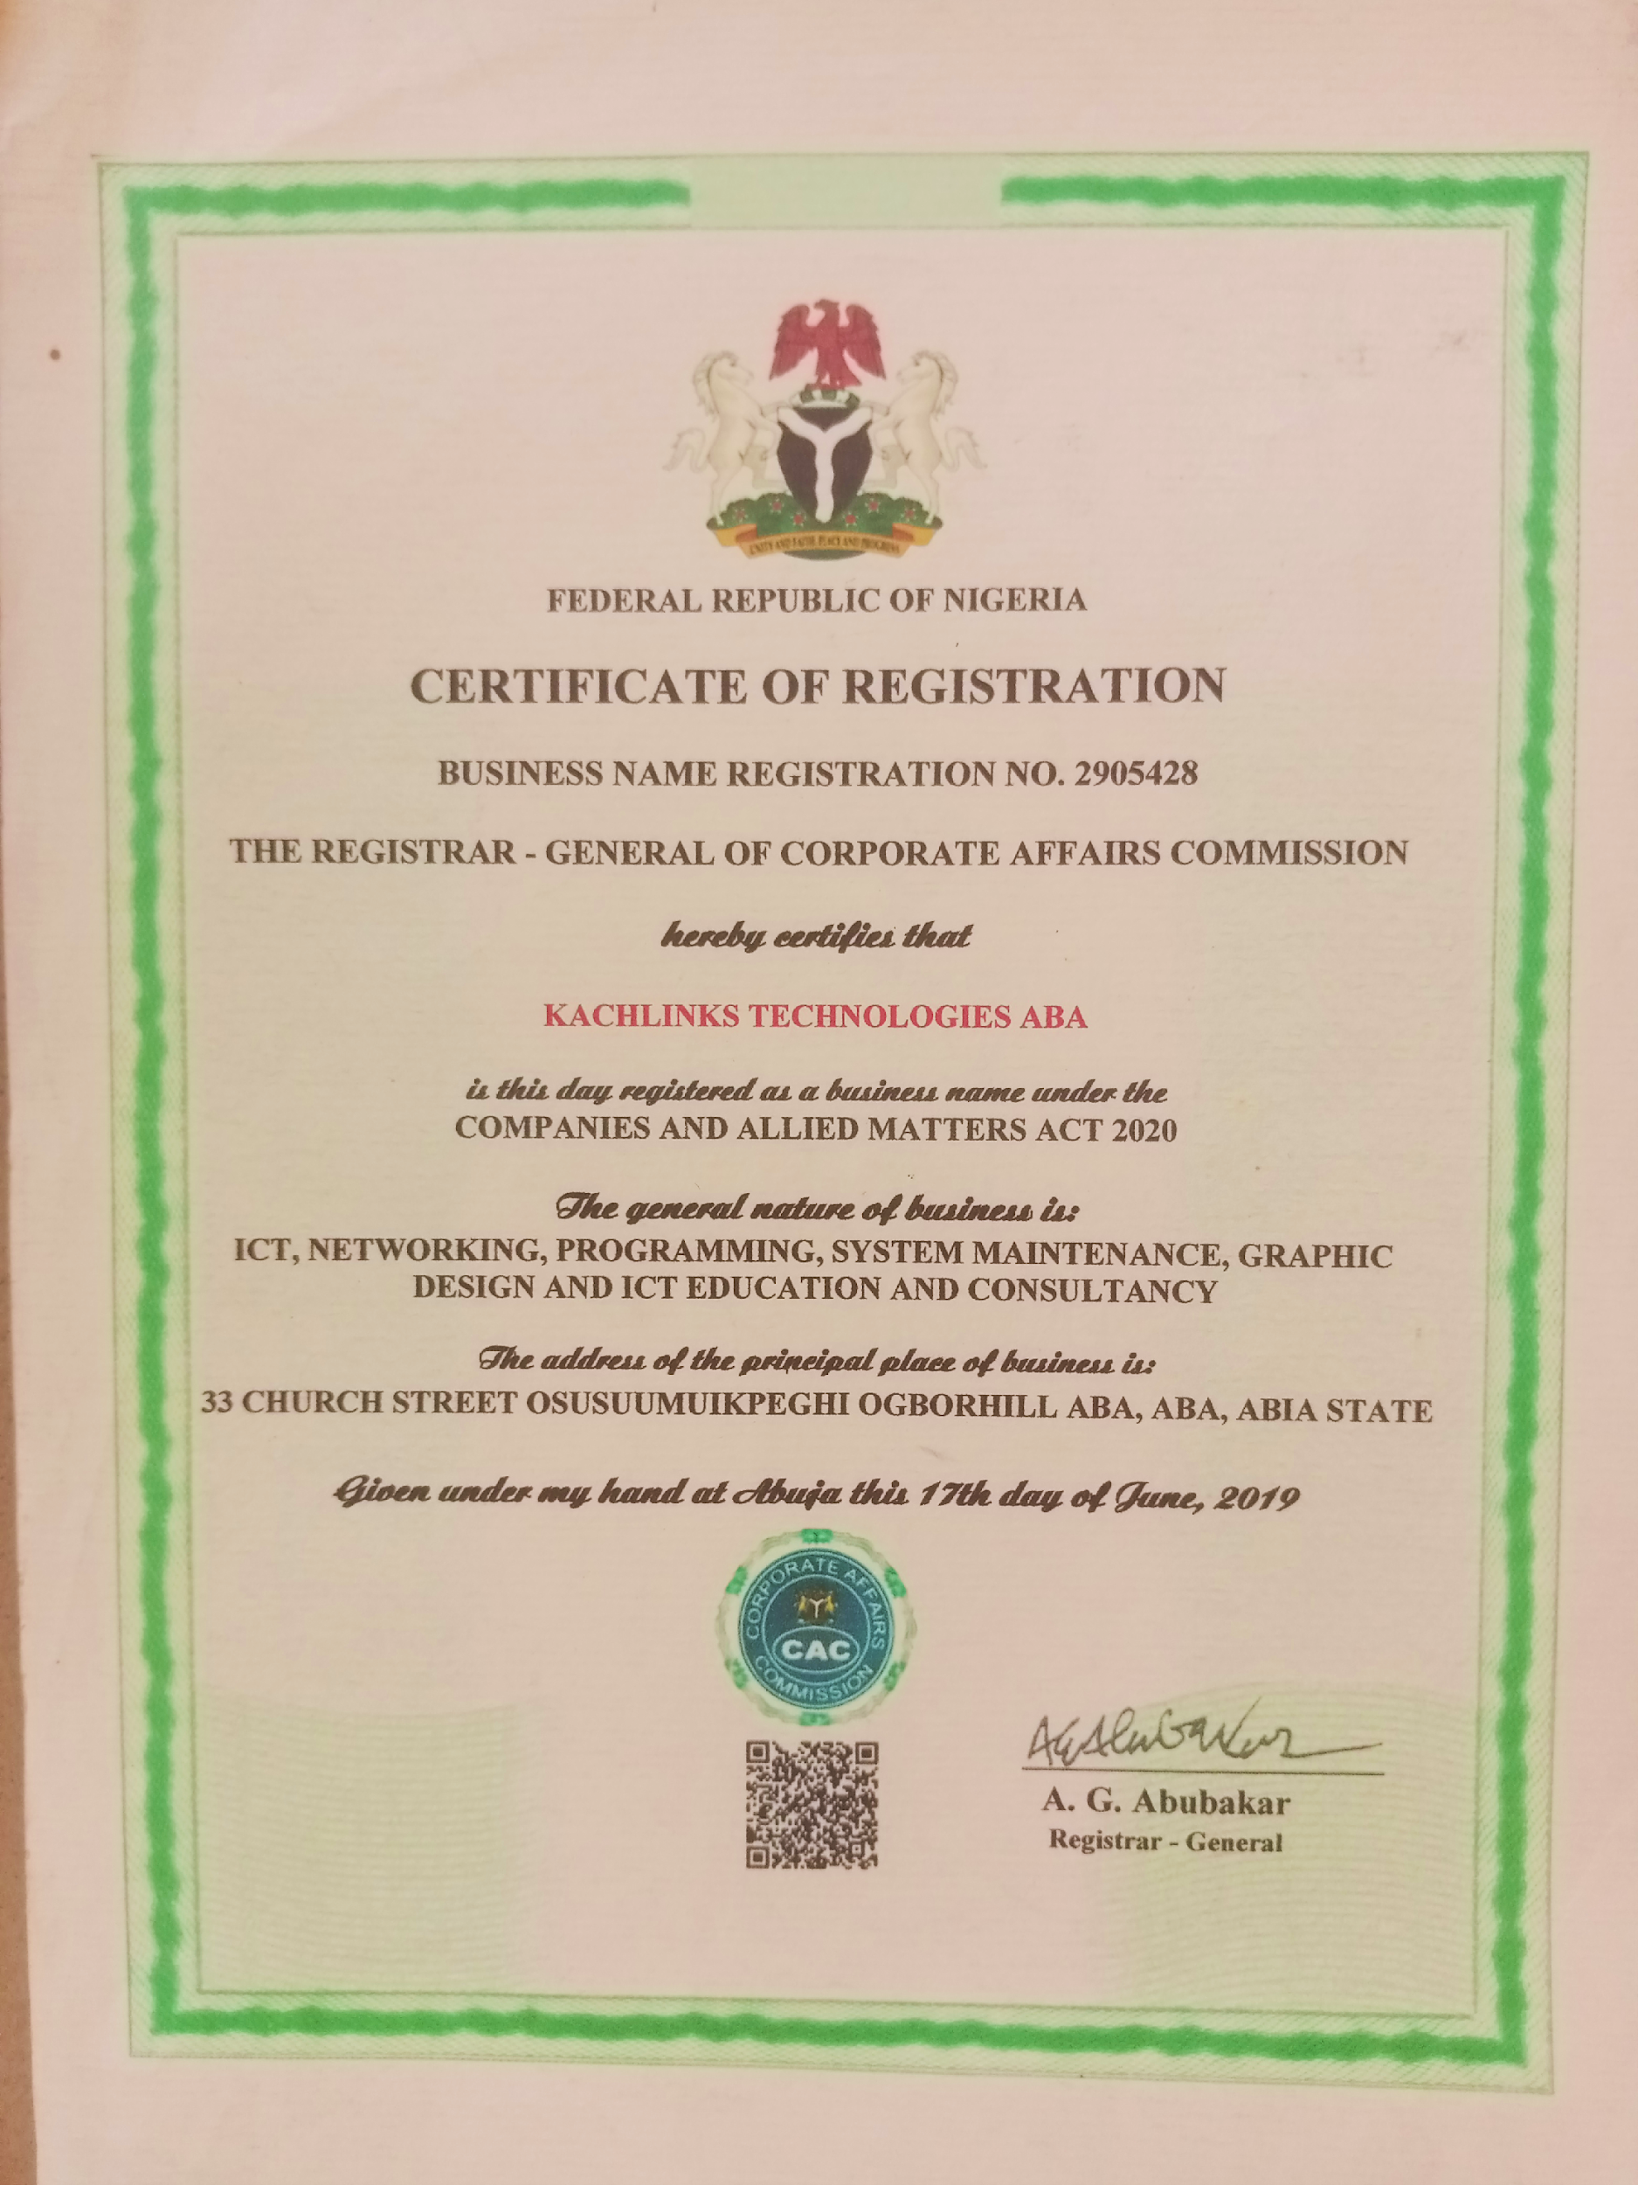
Business Registration

Slide 21
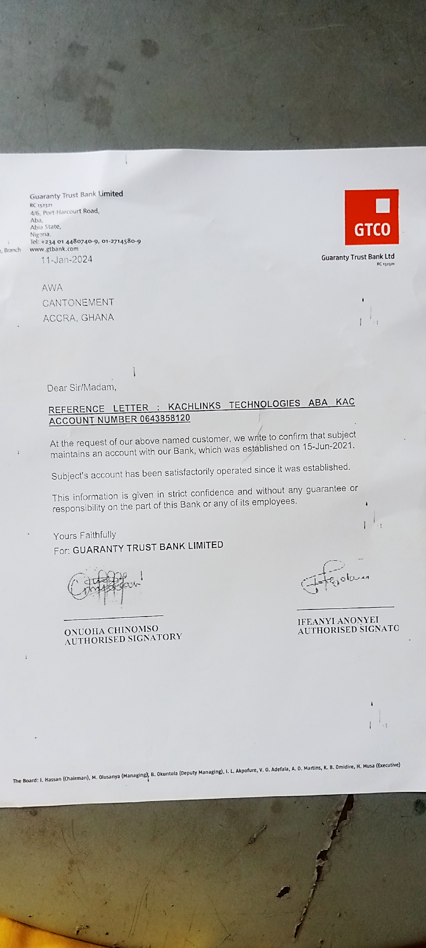
Bank Account Reference letter

